Slide 1

Policymakers' Dashboard (UC2)
23 October 2025

Slide 2
Context
The dashboard must enable "Policymakers to promptly monitor specific phenomena in the EDs, from organisational (e.g. boarding time) and epidemiological (e.g. the emergence of infectious diseases) perspectives"
Requirements for the dashboard
To allow the monitoring of an ED network at a regional scale
To update information in near real-time for readiness and prompt decision-making
To support detailed performance and quality measures
To achieves originality and innovation, as requested by the EU reviewers
To provide user-centred, intuitive experience

Slide 3
Presentation contents
A new wireframe for the policymakers' dashboard
Introduction of innovative indicators
A study for a reliable boarding measure
A new objective measure for ED crowding developed by the Mario Negri Institute
Discussion

Slide 4
Dashboard wireframe

Slide 5
Dashboard structure
REAL TIME ALERTS
LONG TERM ANALYSIS
Performance and Quality - Stats Analysis
Alert page
(home page)
Performance and Quality - Time series
Epidemiological Data - Time series

Slide 6
Dashboard structure
REAL TIME ALERTS
LONG TERM ANALYSIS
Performance and Quality - Stats Analysis
Alert page
(home page)
Performance and Quality - Time series
Epidemiological Data - Time series

Slide 7
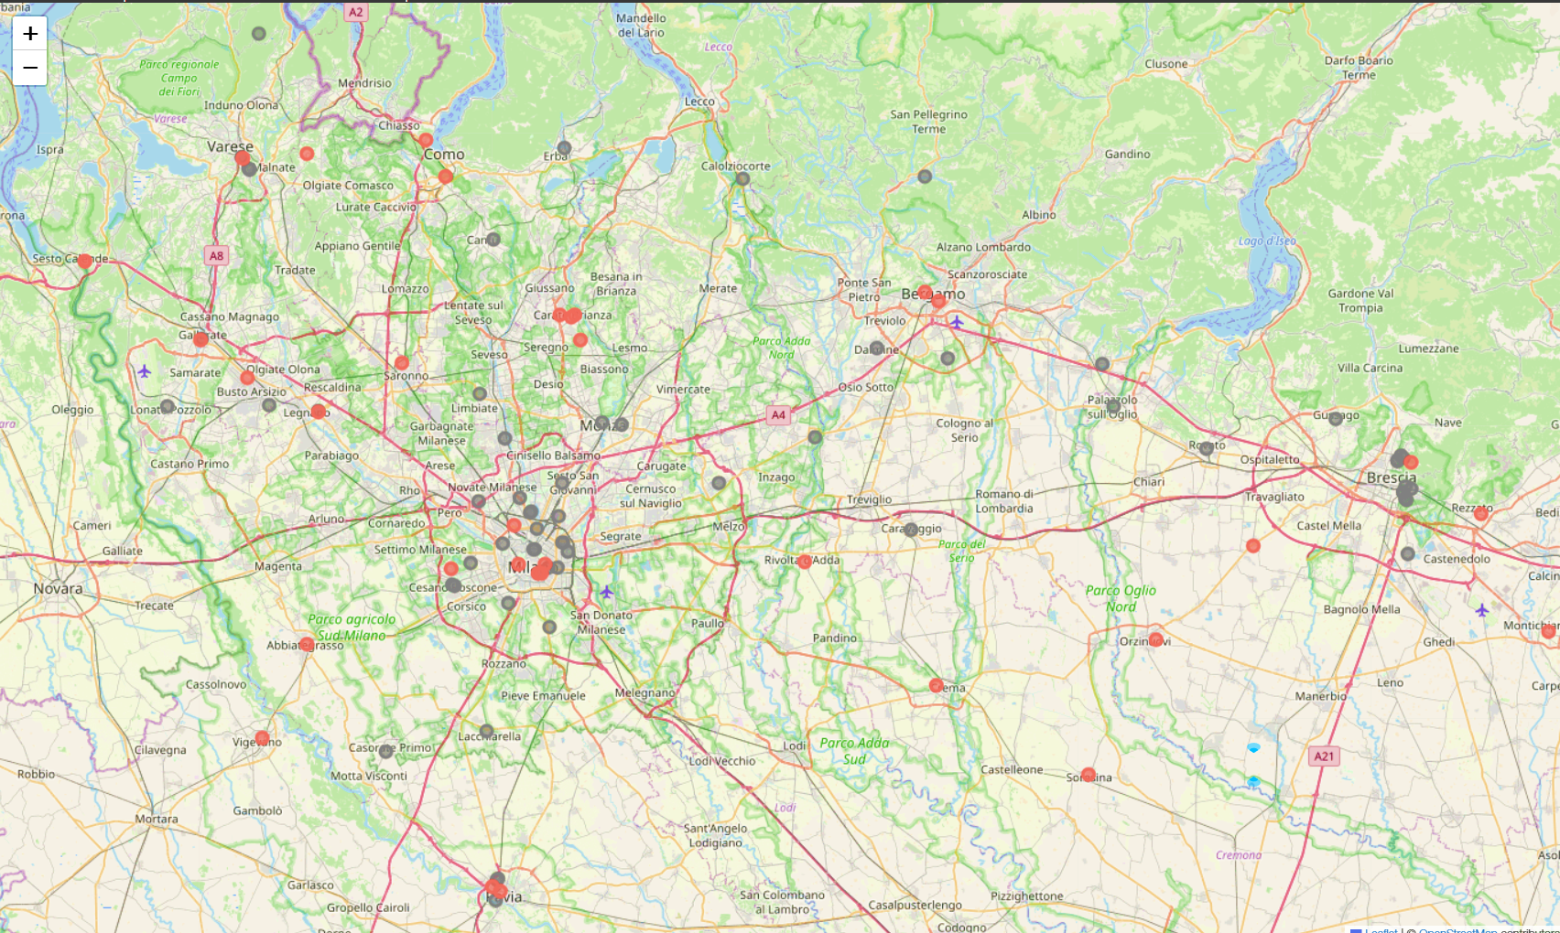
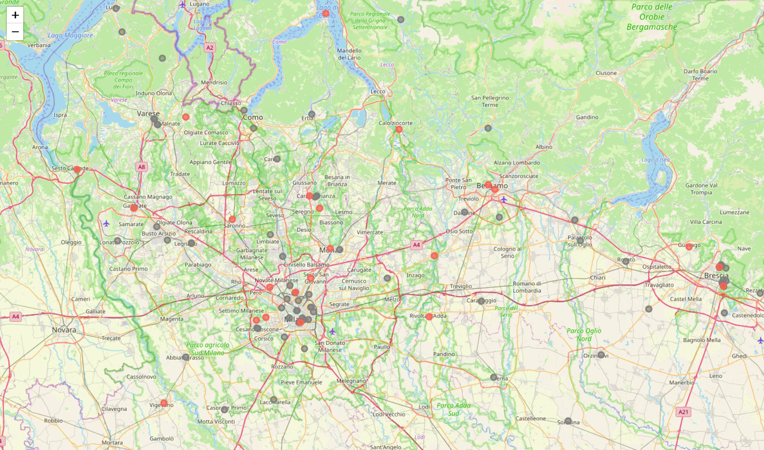

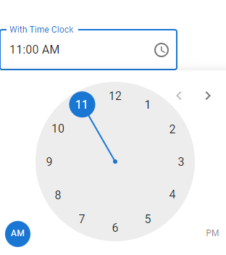
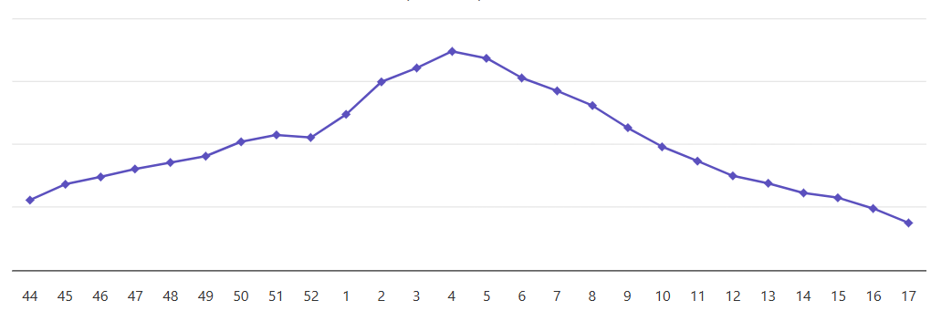
Alert Performance and Quality - Stats Analysis Performance and Quality - Time series Epidemiological Data - Time series Preferred 
EDs condition alerts
Epidemiological alerts
Date selection
15/03/2023
01/01/2021
31/12/2023
Overcrowding: SEVERE
Average Boarding Time > 6 h
Hour selection
Influenza weekly cases: +35%
Meningitis n. cases/3 days : 4
Aggregate marker
Overcrowding
Admissions
Boarding
Aggregate marker
Influenza
COVID-19
Meningitis
Regional values
Influenza
COVID-19
Meningitis
N. of EDs with SEVERE overcrowding
25 / 98
(25%)
N. of arrivals in last 24h
327
MODERATE
N. of patients with boarding time > 6 h
10 / 18
NORMAL
N. of ED episodes
N. of ED episodes
Weekly
N. of ED episodes
3

Slide 8
Dashboard structure
REAL TIME ALERTS
LONG TERM ANALYSIS
Performance and Quality - Stats Analysis
Alert page
(home page)
Performance and Quality - Time series
Epidemiological Data - Time series

Slide 9



Alert Performance and Quality - Stats Analysis Performance and Quality - Time series Epidemiological Data - Time series Preferred 
ELEMENT SELECTION
First period
01/01/2021
31/12/2023
Second period
01/01/2021
31/12/2023
☐ Hospitals comparison
Variables for ED episode
Lenght of wait for visit
Lenght of visit
Lenght of stay
Lenght of boarding
Dimensions for ED episode
Patient's age range
Patient's sex
Arrival mode
Triage priority
Main problem at triage
ED outcome
ED diagnosis
Admission specialty
Variables for ED organization
Overcrowding measure
Boarding measure
Dimensions for ED organization
ED type
ED n. of beds ranges

Slide 10



Alert Performance and Quality - Stats Analysis Performance and Quality - Time series Epidemiological Data - Time series Preferred 
N. of cases / ED outcome
(N. of cases = 396)
Filters for ED episode attributes
☐ Patient's age range
☐ Patient's sex
☐ Arrival mode
☐ Triage priority
☐ Main problem at triage
☐ ED outcome
☐ ED diagnosis
☐ Admission specialty
Filters for ED organization attributes
☐ ED type
☑ ED n. of beds ranges
☑ 1-10
☑ 11-20
☐ 21-30
☐ 31-40
☐ 41-50
ELEMENT SELECTION
FILTERS
First period
01/01/2023
15/06/2023
ED outcome | N | %
TOT | 252
Admitted | 34 | 13,49%
Discharged | 198 | 78,57%
Transferred | 1 | 0,40%
Abandon before visit | 15 | 5,95%
Abandon after visit | 4 | 1,59%
01/01/2021
31/12/2023
Second period
01/01/2021
31/12/2023
Discharged home
Value: 198 (81%)
☐ Hospitals comparison
Variables for ED episode
Lenght of wait for visit
Lenght of visit
Lenght of stay
Lenght of boarding
Dimensions for ED episode
Patient's age range
Patient's sex
Arrival mode
Triage priority
Main problem at triage
ED outcome
ED diagnosis
Admission specialty
Variables for ED organization
Overcrowding measure
Boarding measure
Dimensions for ED organization
ED type
ED n. of beds ranges
A "Dimension," or qualitative variable, is reported as the count of ED episodes for each of its values

Slide 11
Alert Performance and Quality - Stats Analysis Performance and Quality - Time series Epidemiological Data - Time series Preferred 
N. of cases / ED outcome
(N. of cases = 396)
Filters for ED episode attributes
☐ Patient's age range
☐ Patient's sex
☐ Arrival mode
☐ Triage priority
☐ Main problem at triage
☐ ED outcome
☐ ED diagnosis
☐ Admission specialty
Filters for ED organization attributes
☐ ED type
☐ ED n. of beds ranges
ELEMENT SELECTION
FILTERS
First period
ED outcome |  | N. of cases | %
Hospital 1 | TOT | 83
 | Admitted | 12 | 14,46%
 | Discharged | 65 | 78,31%
 | Transferred | 0 | 0,00%
 | Abandon before visit | 5 | 6,02%
 | Abandon after visit | 1 | 1,20%
Hospital 2 | TOT | 71
 | Admitted | 8 | 11,27%
 | Discharged | 58 | 81,69%
 | Transferred | 0 | 0,00%
 | Abandon before visit | 4 | 5,63%
 | Abandon after visit | 1 | 1,41%
Hospital 3 | TOT | 98
 | Admitted | 14 | 14,29%
 | Discharged | 75 | 76,53%
 | Transferred | 1 | 1,02%
 | Abandon before visit | 6 | 6,12%
 | Abandon after visit | 2 | 2,04%
01/01/2023
15/06/2023
01/01/2021
31/12/2023
Second period
01/01/2021
31/12/2023
☑ Hospitals comparison
Variables for ED episode
Lenght of wait for visit
Lenght of visit
Lenght of stay
Lenght of boarding
Dimensions for ED episode
Patient's age range
Patient's sex
Arrival mode
Triage priority
Main problem at triage
ED outcome
ED diagnosis
Admission specialty
Variables for ED organization
Overcrowding measure
Boarding measure
Dimensions for ED organization
ED type
ED n. of beds ranges

Slide 12
Alert Performance and Quality - Stats Analysis Performance and Quality - Time series Epidemiological Data - Time series Preferred 
ED outcome/ Triage priority code
(N. of cases = 396)
Filters for ED episode attributes
☐ Patient's age range
☐ Patient's sex
☐ Arrival mode
☐ Triage priority
☐ Main problem at triage
☐ ED outcome
☐ ED diagnosis
☐ Admission specialty
Filters for ED organization attributes
☐ ED type
☐ ED n. of beds ranges
ELEMENT SELECTION
FILTERS
First period
01/01/2023
15/06/2023
 | Triage priority code
 | 1 | 2 | 3 | 4 | 5
ED outcome
Admitted | 3 (100%) | 15 (45.5%) | 12 (16.0%) | 4 (5.7%) | 0 (0%)
Discharged | 0 (0%) | 17 (51.5%) | 60 (80.0%) | 60 (85.7%) | 61 (85.9%)
Transferred | 0 (0%) | 1 (3.0%) | 0 (0%) | 0 (0%) | 0 (0%)
Abandon before visit | 0 (0%) | 0 (0%) | 2 (2.7%) | 5 (7.1%) | 8 (11.3%)
Abandon after visit | 0 (0%) | 0 (0%) | 1 (1.3%) | 1 (1.4%) | 2 (2.8%)
Patient's sex
Female | 1 (33.3%) | 17 (51.5%) | 38 (50.7%) | 35 (50.0%) | 35 (49.3%)
Male | 2 (66.7%) | 16 (48.5%) | 37 (49.3%) | 35 (50.0%) | 36 (50.7%)
Other | 0 (0%) | 0 (0%) | 0 (0%) | 0 (0%) | 0 (0%)
01/01/2021
31/12/2023
Second period
01/01/2021
31/12/2023
☐ Hospitals comparison
Variables for ED episode
Lenght of wait for visit
Lenght of visit
Lenght of stay
Lenght of boarding
Dimensions for ED episode
Patient's age range
Patient's sex
Arrival mode
Triage priority
Main problem at triage
ED outcome
ED diagnosis
Admission specialty
Variables for ED organization
Overcrowding measure
Boarding measure
Dimensions for ED organization
ED type
ED n. of beds ranges

Slide 13
Alert Performance and Quality - Stats Analysis Performance and Quality - Time series Epidemiological Data - Time series Preferred 
ED outcome/ Triage priority code
(N. of cases = 396)
Filters for ED episode attributes
☐ Patient's age range
☐ Patient's sex
☐ Arrival mode
☐ Triage priority
☐ Main problem at triage
☐ ED outcome
☐ ED diagnosis
☐ Admission specialty
Filters for ED organization attributes
☐ ED type
☐ ED n. of beds ranges
ELEMENT SELECTION
FILTERS
First period
01/01/2023
15/06/2023
 |  | Triage priority code
 | ED outcome | 1 | 2 | 3 | 4 | 5
Hospital 1 | TOT | 1 (1.2%) | 11 (13.3%) | 25 (30.1%) | 23 (27.7%) | 1 (1.2%)
 | Admitted | 1 (100%) | 6 (54.5%) | 4 (16.0%) | 1 (4.3%) | 1 (100%)
 | Discharged | 0 (0%) | 5 (45.5%) | 21 (84.0%) | 20 (87.0%) | 0 (0%)
 | Transferred | 0 (0%) | 0 (0%) | 0 (0%) | 0 (0%) | 0 (0%)
 | Abandon before visit | 0 (0%) | 0 (0%) | 0 (0%) | 2 (8.7%) | 0 (0%)
 | Abandon after visit | 0 (0%) | 0 (0%) | 0 (0%) | 0 (0%) | 0 (0%)
Hospital 2 | TOT | 1 (1.4%) | 9 (12.7%) | 21 (29.6%) | 20 (28.2%) | 1 (1.4%)
 | Admitted | 1 (100%) | 4 (44.4%) | 3 (14.3%) | 0 (0%) | 1 (100%)
 | Discharged | 0 (0%) | 5 (55.6%) | 18 (85.7%) | 18 (90.0%) | 0 (0%)
 | Transferred | 0 (0%) | 0 (0%) | 0 (0%) | 0 (0%) | 0 (0%)
 | Abandon before visit | 0 (0%) | 0 (0%) | 0 (0%) | 2 (10.0%) | 0 (0%)
 | Abandon after visit | 0 (0%) | 0 (0%) | 0 (0%) | 0 (0%) | 0 (0%)
Hospital 3 | TOT | 1 (1.0%) | 13 (13.3%) | 29 (29.6%) | 28 (28.6%) | 1 (1.0%)
 | Admitted | 1 (100%) | 7 (53.8%) | 5 (17.2%) | 1 (3.6%) | 1 (100%)
 | Discharged | 0 (0%) | 6 (46.2%) | 23 (79.3%) | 24 (85.7%) | 0 (0%)
 | Transferred | 0 (0%) | 0 (0%) | 1 (3.4%) | 0 (0%) | 0 (0%)
 | Abandon before visit | 0 (0%) | 0 (0%) | 0 (0%) | 2 (7.1%) | 0 (0%)
 | Abandon after visit | 0 (0%) | 0 (0%) | 0 (0%) | 1 (3.6%) | 0 (0%)
01/01/2021
31/12/2023
Second period
01/01/2021
31/12/2023
☑ Hospitals comparison
Variables for ED episode
Lenght of wait for visit
Lenght of visit
Lenght of stay
Lenght of boarding
Dimensions for ED episode
Patient's age range
Patient's sex
Arrival mode
Triage priority
Main problem at triage
ED outcome
ED diagnosis
Admission specialty
Variables for ED organization
Overcrowding measure
Boarding measure
Dimensions for ED organization
ED type
ED n. of beds ranges

Slide 14
Alert Performance and Quality - Stats Analysis Performance and Quality - Time series Epidemiological Data - Time series Preferred 
Lenght of visit
(N. of cases = 396)
Filters for ED episode attributes
☐ Patient's age range
☐ Patient's sex
☐ Arrival mode
☐ Triage priority
☐ Main problem at triage
☐ ED outcome
☐ ED diagnosis
☐ Admission specialty
Filters for ED organization attributes
☐ ED type
☐ ED n. of beds ranges
ELEMENT SELECTION
FILTERS
First period
01/01/2023
15/06/2023
01/01/2021
31/12/2023
Stat | LOS (minutes)
Mean (SD) | 46 (15)
Median (Q1, Q3) | 47 (35, 57)
Min, Max | 1, 100
Second period
01/01/2021
31/12/2023
☐ Hospitals comparison
Variables for ED episode
Lenght of wait for visit
Lenght of visit
Lenght of stay
Lenght of boarding
Dimensions for ED episode
Patient's age range
Patient's sex
Arrival mode
Triage priority
Main problem at triage
ED outcome
ED diagnosis
Admission specialty
Variables for ED organization
Overcrowding measure
Boarding measure
Dimensions for ED organization
ED type
ED n. of beds ranges
A "Variable," or quantitative variable, is reported as a statistical distribution of its values

Slide 15
Alert Performance and Quality - Stats Analysis Performance and Quality - Time series Epidemiological Data - Time series Preferred 
Lenght of visit
(N. of cases = 396)
Filters for ED episode attributes
☐ Patient's age range
☐ Patient's sex
☐ Arrival mode
☐ Triage priority
☐ Main problem at triage
☐ ED outcome
☐ ED diagnosis
☐ Admission specialty
Filters for ED organization attributes
☐ ED type
☐ ED n. of beds ranges
ELEMENT SELECTION
FILTERS
First period
01/01/2023
15/06/2023
Lenght of visit (minutes)
Lenght of visit (minutes)
Hospital 1 | Mean (SD) | 42 (13)
 | Median (Q1, Q3) | 43 (32, 53)
 | Min, Max | 1, 95
Hospital 2 | Mean (SD) | 46 (15)
 | Median (Q1, Q3) | 47 (36, 58)
 | Min, Max | 2, 98
Hospital 3 | Mean (SD) | 50 (16)
 | Median (Q1, Q3) | 51 (38, 63)
 | Min, Max | 3, 100
01/01/2021
31/12/2023
Hospital 1
Mean (SD): 42 (13)
Median (Q1, Q3): 43 (32, 53)
Min, Max: 1, 95
Second period
01/01/2021
31/12/2023
*
*
☑ Hospitals comparison
*
Variables for ED episode
Lenght of wait for visit
Lenght of visit
Lenght of stay
Lenght of boarding
Dimensions for ED episode
Patient's age range
Patient's sex
Arrival mode
Triage priority
Main problem at triage
ED outcome
ED diagnosis
Admission specialty
Variables for ED organization
Overcrowding measure
Boarding measure
Dimensions for ED organization
ED type
ED n. of beds ranges

Slide 16
Alert Performance and Quality - Stats Analysis Performance and Quality - Time series Epidemiological Data - Time series Preferred 
Lenght of visit/ ED outcome
(N. of cases = 396)
Filters for ED episode attributes
☐ Patient's age range
☐ Patient's sex
☐ Arrival mode
☐ Triage priority
☐ Main problem at triage
☐ ED outcome
☐ ED diagnosis
☐ Admission specialty
Filters for ED organization attributes
☐ ED type
☐ ED n. of beds ranges
ELEMENT SELECTION
FILTERS
First period
01/01/2023
15/06/2023
Lenght of visit (minutes)
 | Lenght of visit
ED outcome | Mean (SD) | Median (Q1, Q3) | Min, Max
Admitted | 72 (11) | 71 (63, 83) | 45, 92
Discharged | 48 (13) | 49 (33, 63) | 10, 88
Transferred | 68 (9) | 69 (60, 76) | 40, 90
Abandon before visit | 13 (4) | 12 (9, 18) | 3, 28
Abandon after visit | 33 (9) | 32 (26, 40) | 15, 58
01/01/2021
31/12/2023
Second period
*
*
01/01/2021
31/12/2023
*
☐ Hospitals comparison
*
*
Variables for ED episode
Lenght of wait for visit
Lenght of visit
Lenght of stay
Lenght of boarding
Dimensions for ED episode
Patient's age range
Patient's sex
Arrival mode
Triage priority
Main problem at triage
ED outcome
ED diagnosis
Admission specialty
Variables for ED organization
Overcrowding measure
Boarding measure
Dimensions for ED organization
ED type
ED n. of beds ranges

Slide 17
Alert Performance and Quality - Stats Analysis Performance and Quality - Time series Epidemiological Data - Time series Preferred 
Lenght of visit
ED outcome
(N. of cases = 815)
Filters for ED episode attributes
☐ Patient's age range
☐ Patient's sex
☐ Arrival mode
☐ Triage priority
☐ Main problem at triage
☐ ED outcome
☐ ED diagnosis
☐ Admission specialty
Filters for ED organization attributes
☐ ED type
☐ ED n. of beds ranges
ELEMENT SELECTION
FILTERS
First period
 | First Period | Second Period
Lenght of visit
Mean (SD) | 53 (15) | 46 (13)
Median (Q1, Q3) | 52 (35, 67) | 48 (31,66)
Min, Max | 3, 94 | 1,93
ED outcome | 252
Admitted | 34 (13%) | 28 (14%)
Discharged | 198 (78%) | 211 (77%)
Transferred | 1 (0,5%) | 3 (0,5%)
Abandon before visit | 15 (6%) | 18 (6%)
Abandon after visit | 4 (2%) | 2 (2%)
01/01/2023
15/06/2023
01/01/2021
31/12/2023
Second period
16/06/2023
01/01/2021
31/12/2023
☐ Hospitals comparison
Variables for ED episode
Lenght of wait for visit
Lenght of visit
Lenght of stay
Lenght of boarding
Dimensions for ED episode
Patient's age range
Patient's sex
Arrival mode
Triage priority
Main problem at triage
ED outcome
ED diagnosis
Admission specialty
Variables for ED organization
Overcrowding measure
Boarding measure
Dimensions for ED organization
ED type
ED n. of beds ranges

Slide 18
Dashboard structure
REAL TIME ALERTS
LONG TERM ANALYSIS
Performance and Quality - Stats Analysis
Alert page
(home page)
Performance and Quality - Time series
Epidemiological Data - Time series

Slide 19
Alert Performance and Quality - Stats Analysis Performance and Quality - Time series Epidemiological Data - Time series Preferred 
Arrival mode
(N. of cases = 412)
Filters for ED episode attributes
☐ Patient's age range
☐ Patient's sex
☐ Arrival mode
☐ Triage priority
☐ Main problem at triage
☐ ED outcome
☐ ED diagnosis
☐ Admission specialty
Filters for ED organization attributes
☐ ED type
☑ ED n. of beds ranges
☑ 1-10
☑ 11-20
☐ 21-30
☐ 31-40
☐ 41-50
ELEMENT SELECTION
FILTERS
First period
Self-presented
Week 11
Value: 52 (81%)
01/01/2022
31/03/2022
01/01/2021
31/12/2023
Second period
01/01/2023
31/03/2023
01/01/2021
31/12/2023
First period
Temporal unit
☐ hour ☐ day ☑ week ☐ month
☐ year ☐ day of the week
Variables for ED episode
☐ Lenght of wait for visit (mean)
☐ Lenght of visit (mean)
☐ Lenght of stay (mean)
☐ Lenght of boarding (mean)
Dimensions for ED episode
☐ Patient's age range
☐ Patient's sex
☑ Arrival mode
☐ Triage priority
☐ Main problem at triage
☐ ED outcome
☐ ED diagnosis
☐ Admission specialty
Variables for ED organization
☐ Overcrowding measure
☐ Boarding measure
Second period

Slide 20
Dashboard structure
REAL TIME ALERTS
LONG TERM ANALYSIS
Performance and Quality - Stats Analysis
Alert page
(home page)
Performance and Quality - Time series
Epidemiological Data - Time series

Slide 21
Alert Performance and Quality - Stats Analysis Performance and Quality - Time series Epidemiological Data - Time series Preferred 
Arrival mode
(N. of cases = 412)
Filters for ED episode attributes
☐ Patient's age range
☐ Patient's sex
☐ Arrival mode
☐ Triage priority
☐ Main problem at triage
☐ ED outcome
☐ ED diagnosis
☐ Admission specialty
Filters for ED organization attributes
☐ ED type
☐ ED n. of beds ranges
ELEMENT SELECTION
FILTERS
First period
01/01/2022
31/03/2022
01/01/2021
31/12/2023
Second period
01/01/2023
31/03/2023
01/01/2021
31/12/2023
Admitted
Week 10
Value: 5
First period
Temporal unit
☐ hour ☐ day ☑ week ☐ month
☐ year ☐ day of the week
N. of cases in ED
◉ Influenza
○ COVID-19
Meningitis
ED episode attributes
☐ Patient's age range
☐ Patient's sex
☐ Arrival mode
☐ Triage priority
☑ ED outcome
☐ ED diagnosis
☐ Admission specialty
Second period

Slide 22
Innovative indicators A study for the boarding measurement

Slide 23


Boarding definition
The boarding is the elapsed time between the admission decision to when patients departed the ED
Triage
Visit
Decision to admit
Admission
Boarding

Slide 24

Boarding measures
Actual measure
Triage
Visit
Decision to admit
Admission
EHR

Slide 25
Boarding measures
Used proxies
Triage
Visit
Decision to admit
Admission
6 hours
proxy A
8 hours
proxy B
Are they good?
For discussion: do you use other measures?

Slide 26
A gold standard
Identified 10 hospitals in Lombardy Region with reliable registration in EHR of Decision to Admit
Small, medium and big size EDs
"Cleaned" admissions from EDs, since 1 January to 30 September 2025 = 22.190

Slide 27
The ongoing study
To evaluate the reliability of the current proxy boarding measures
To look for a better measure by changing the calculation model
using episode attributes (i.e. symptoms at arrival) and ED variables (i.e. annual number of accesses)
using information from the diagnostic tests executed during the ED stay

Slide 28
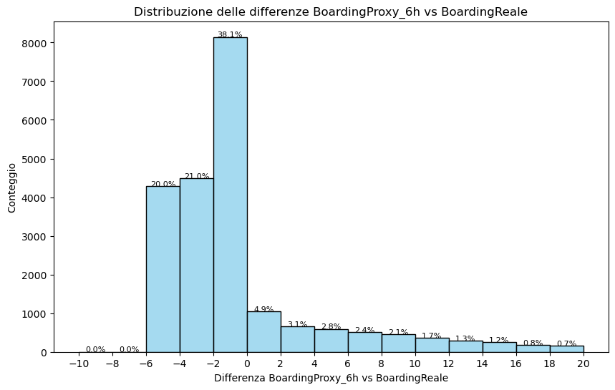
First indications about current proxies
Analysis of boarding proxy 6 hours since visit
Almost identical results for proxy 8 h since triage
Statistical findings are controversial:
proxy mean 13 h vs 12 h actual mean
correlation between proxy and actual measure appears to be high
but the overall mean error measure is 4.5 hours
for about 80% of cases, the actual boarding time is longer than the proxy
➔a more complex proxy model is worth pursuing
In most cases, boarding begins less than 8 hours after triage and less than 6 hours after the physician's visit

Slide 29
Multiple linear regression models
Model using clinical and operational variables for single episodes
Type of ED
Day of the week and time of the visit / triage
Time from anticipated nurse actions (if any) to physician's visit
ED Treatment Length (post-visit) / Total ED Length of Stay (LOS)
Chief complaint at arrival / discharge diagnosis
Good approximation, with slight improvements.
However, errors relatively high and these models do not meet the requirements for a reliable linear regression model
It's a starting point for developing more advanced approaches, such as non-linear or multilevel models
Opportunity to add variables related to diagnostic test timing
TO BE DESIGNED

Slide 30
Innovative indicators A new objective measure for ED crowding

Slide 31
Measuring ED crowding: state of the art
ED crowding indicators: NEDOCS, EDWIN, READI, …
NEDOCS = 85.5(C/A) + 600(F/B) + 13.4(D) + 0.93(E) + 5.64(G) - 20
Developed in 8 large university hospitals in the US in 2002
A: Number of ED beds
B: Number of hospital beds
C: Number of patients in charge to the ED
D: Number of ventilated patients in the ED
E: Maximum waiting time for the hospital admission
F: Number of patients awaiting hospital admission
G: Maximum waiting time for the medical visit
Heterogeneous approximations!

Slide 32
ED crowding and waiting time for the visit
Emergency Department 1
Triage code
Few!
Waiting time (minutes)
Emergency Department 2
Almost flat!
Flat!
Number of patients present in ED (N)

Slide 33


A new ED crowding indicator
Until 2023, 4-level triage:
Non-urgent
Minor or deferrable urgency
Urgent
Immediate emergency

Slide 34
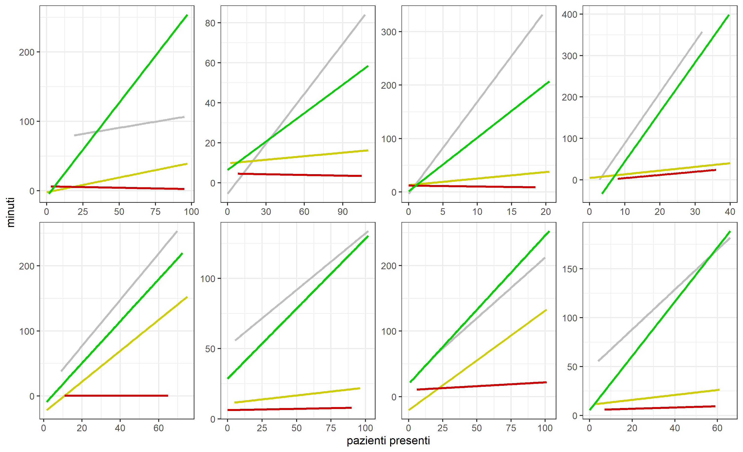
ED crowding and waiting time (4-level triage)
Triage code
Non-urgent
Minor/deferrable
urgency
Waiting time (minutes)
Urgent
Immediate emerg.
Number of patients present in ED (N)

Slide 35
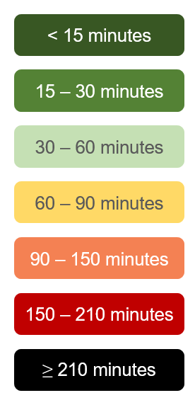
Step 1: cutoffs on waiting time
Cutoffs on the waiting time for patients triaged with
minor or deferrable urgency

Slide 36
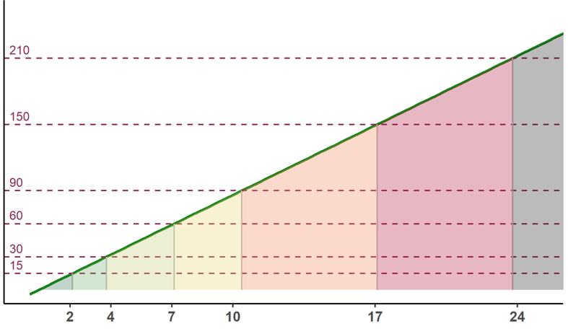
Step 2: cutoffs on the number of patients
Cutoff wait (minutes) | Cutoff patients (N)
15 | 2
30 | 4
60 | 7
90 | 10
150 | 17
210 | 24
Waiting time (minutes)
Tempo di attesa
Number of patients present in ED (N)
Totale pazienti in PS

Slide 37
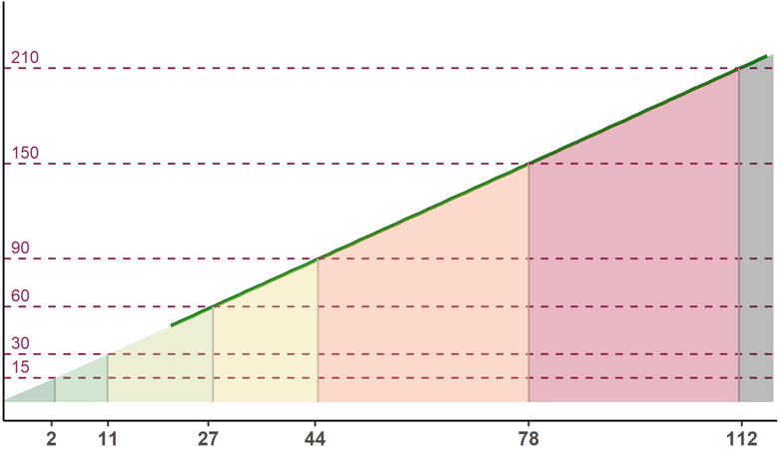
Step 2: cutoffs on the number of patients
Cutoff wait (minutes) | Cutoff patients (N)
15 | 2
30 | 11
60 | 27
90 | 44
150 | 78
210 | 112
Waiting time (minutes)
Tempo di attesa
Number of patients present in ED (N)
Totale pazienti in PS

Slide 38
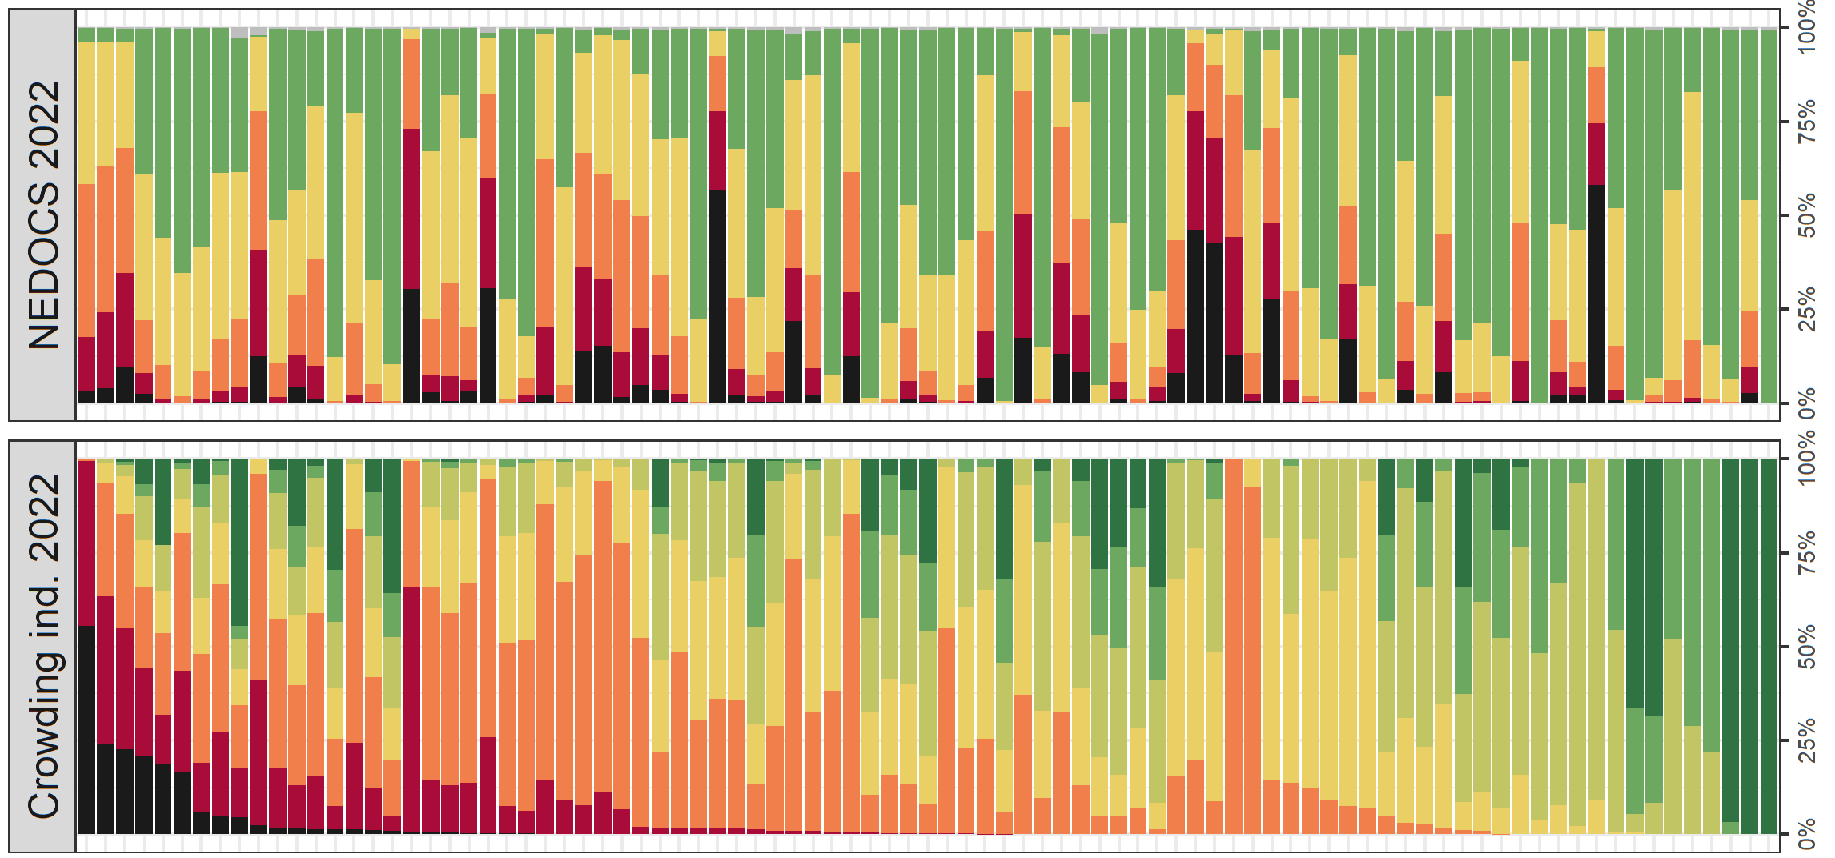
Proposed indicator vs. NEDOCS: distribution
Time in each crowding level (%)
Emergency Department

Slide 39
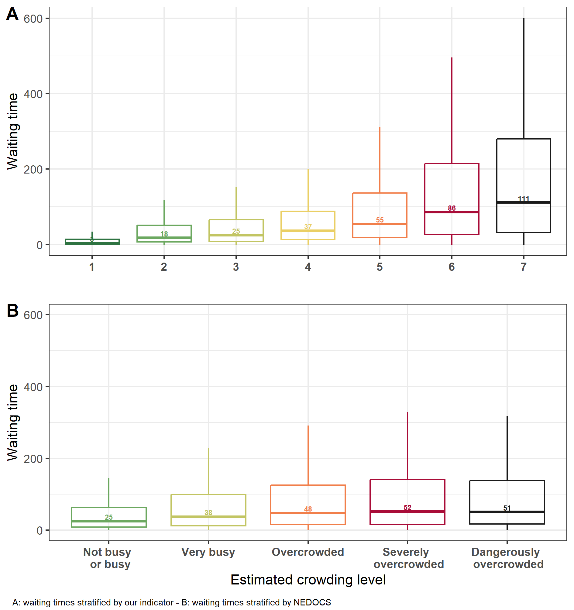
Proposed indicator vs. NEDOCS: waiting time
Proposed indicator
NEDOCS
Waiting time (minutes)
Crowding level
Crowding level

Slide 40

Proposed indicator vs. NEDOCS: ???
Comparing a new crowding indicator and the perception of healthcare professionals in Emergency Department
The CAOS study
Goal: comparing the perception of the ED staff with proposed indicator and NEDOCS
Method: For 60 days (15/10 – 13/12), 1 SMS daily to measure crowding perception

Slide 41
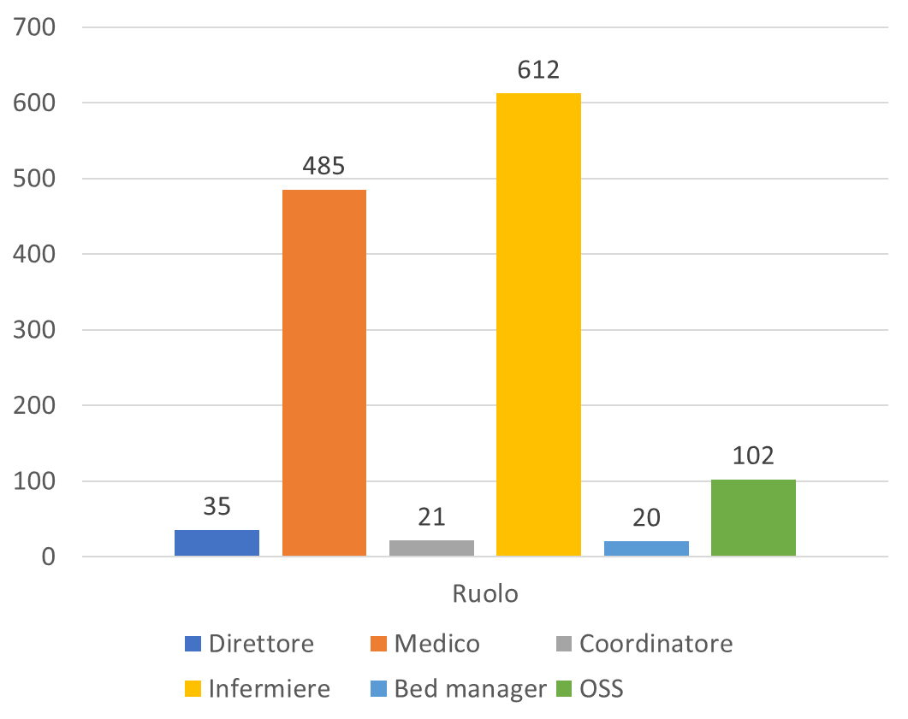
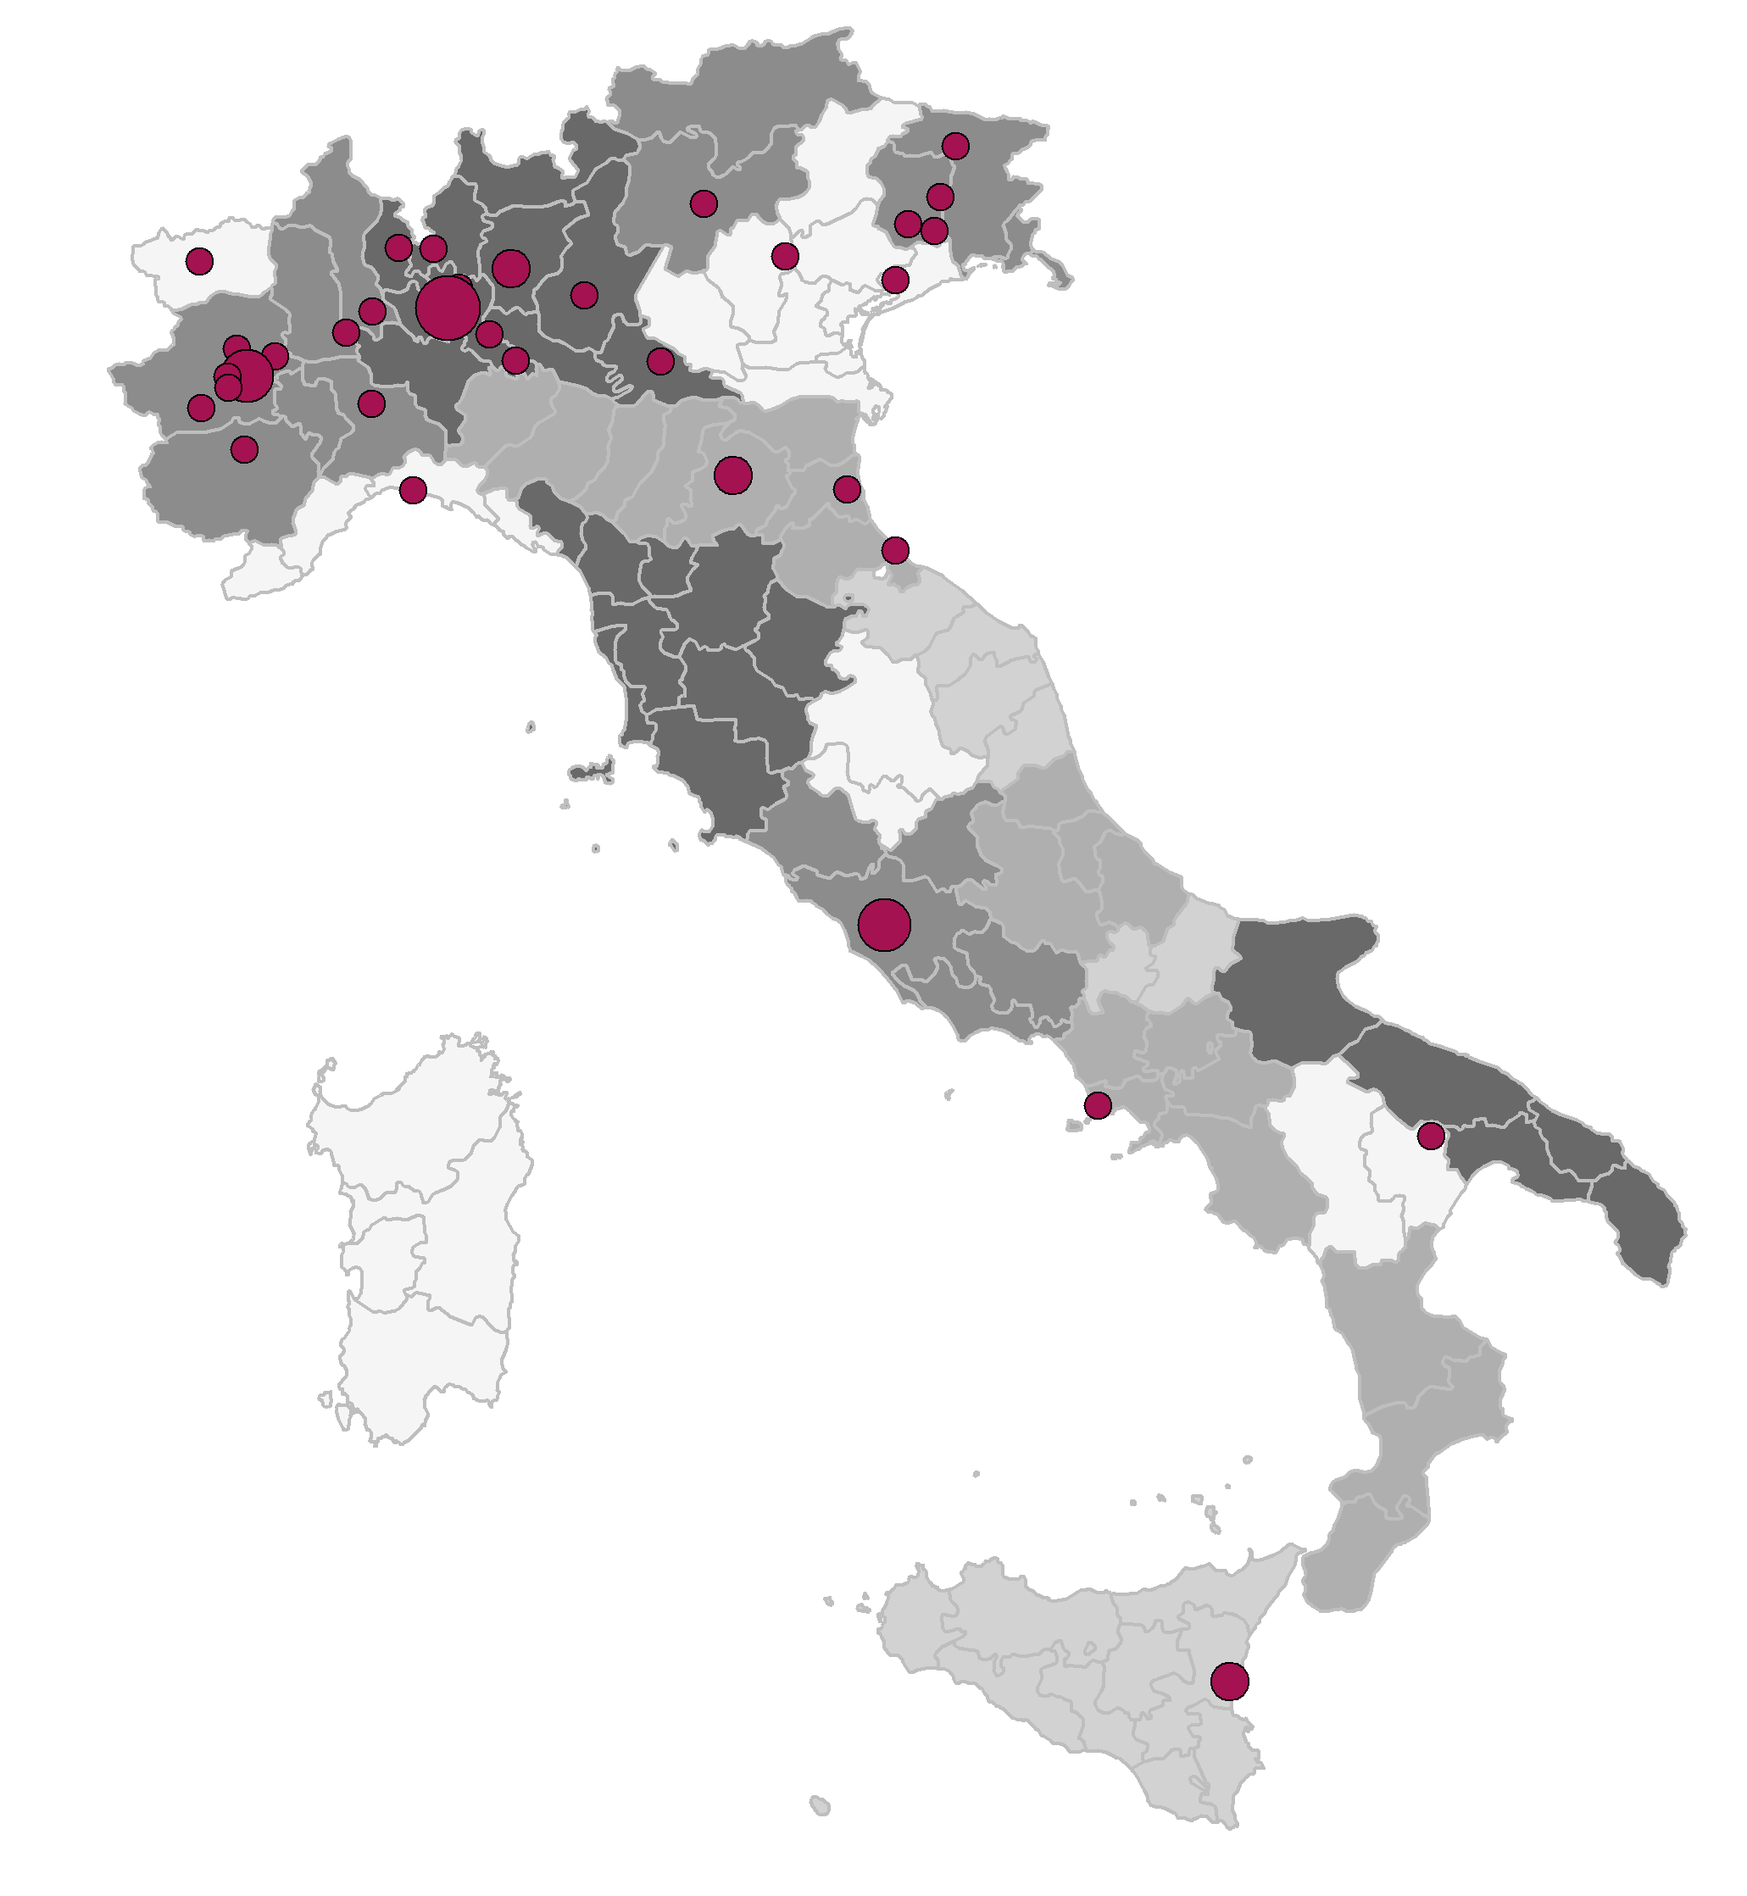

The CAOS study
1 ED
2 EDs
3 EDs or more
Role
52 EDs!
ED director
Physician
Chief nurse
Nurse
Bed manager
Healthcare assistant
1,275 participants!

Slide 42
Improvement of proposed indicator
Triage code for the definition of the indicator?
Minor urgency?
Deferrable urgency?
A combination of both?
A combination of all codes?
Cutoffs?

Slide 43


THANK YOU
FOR YOUR
ATTENTION
ecream@marionegri.it

Slide 44


